Slide 1
Problem Statement
Business contracts are critical documents that define the terms and conditions of agreements between parties.
Manually reviewing and validating these contracts against a template to ensure compliance and identify deviations is time-consuming, error-prone, and resource-intensive.
Automating this process can significantly enhance accuracy, efficiency, and consistency in contract validation.

Slide 2
Unique Idea Brief (Solution)
Our solution automates the business contract validation process using advanced natural language processing (NLP) and machine learning techniques. The system extracts, classifies, compares, and highlights contract content to ensure accuracy and efficiency.
Key Components:
Automated PDF Parsing: Extract text from input and template PDFs for comprehensive analysis.
Named Entity Recognition (NER): Identify and extract key entities like names and dates from the contract text.
Text Classification: Classify contract content into categories such as agreement type, clauses, and headings.
Text Comparison: Compare classified content of the contract with the template to detect deviations.
PDF Highlighting: Visually highlight identified entities and deviations within the contract PDF.
Summary Generation: Create a concise summary highlighting key points and deviations for quick review.

Slide 3
Unique Idea Brief (Solution)
Benefits:
Increased Accuracy: Reduces human errors in contract validation.
Enhanced Efficiency: Speeds up the review process, saving time and resources.
Consistency: Ensures standardized validation across all contracts.
Visibility: Highlights differences clearly for easier review.
Scalability: Handles multiple contracts simultaneously, suitable for businesses of all sizes.

Slide 4
Features Offered
PDF Parsing: Automated extraction and reading of text from PDF documents.
Named Entity Recognition (NER): Identification and extraction of key entities within the contract text.
Text Classification: Classification of contract content based on predefined categories such as agreement type and heading.
Text Comparison: Comparison of contract clauses with a template to identify deviations.
PDF Highlighting: Highlighting of identified entities and deviations within the contract PDF.
Summary Generation: Automated generation of a summary highlighting key points and deviations.

Slide 5
Process Flow
Initialization:
Input and template PDF URLs, agreement type, clause, and heading are provided.
PDF Parsing:
Extract text from both the input and template PDFs.
Named Entity Recognition:
Perform NER on the extracted text to identify and extract key entities.
Text Classification:
Classify the text based on agreement type, clause, and heading.
Text Comparison:
Compare the classified text of the input contract with the template to identify deviations.
PDF Highlighting:
Highlight the deviations and recognized entities in the input contract PDF.
Summary Generation:
Generate a summary of the key points and deviations.

Slide 6
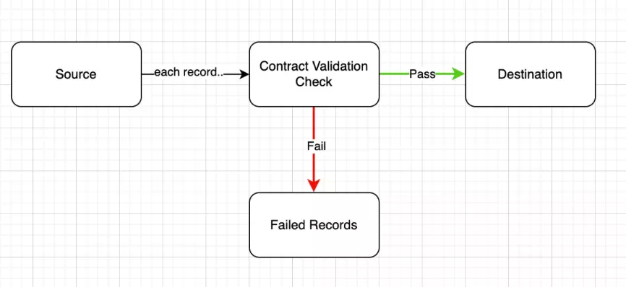
Architecture Diagram

Slide 7
Technologies Used
Python
Core programming language for developing the application.
PDF Libraries:
Tools such as PyPDF2 or PDFMiner for parsing and reading PDFs.
Natural Language Processing (NLP)
Libraries like SpaCy or NLTK for NER and text classification.
Machine Learning
Techniques for classifying and comparing text.
Data Storage
Databases for storing and retrieving contract and template data.
Web Frameworks
Optional frameworks like Flask or Django for building a user interface.

Slide 8
Team members and contribution
Name: Tejaswini Mallappa Mastamardi
USN: 2BL21CI030
College: BLDEA’s Vachana Pitamaha Dr. P. G. Halkatti College of Engineering and Technology Vijayapura
Team Members: 1(Individual)

Slide 9
Conclusion
The automated Business Contract Validation system leverages advanced NLP and machine learning techniques to streamline the contract review process. It ensures higher accuracy, reduces the manual workload, and enhances the overall efficiency of contract management. By automating the tedious and error-prone aspects of contract validation, businesses can focus on more strategic tasks and make informed decisions more quickly.

